Slide 1
Emergence of Bangladesh
Ancient world, subcontinent: Locating Bengal
EMB 101 | Class 1 & 2

Slide 2
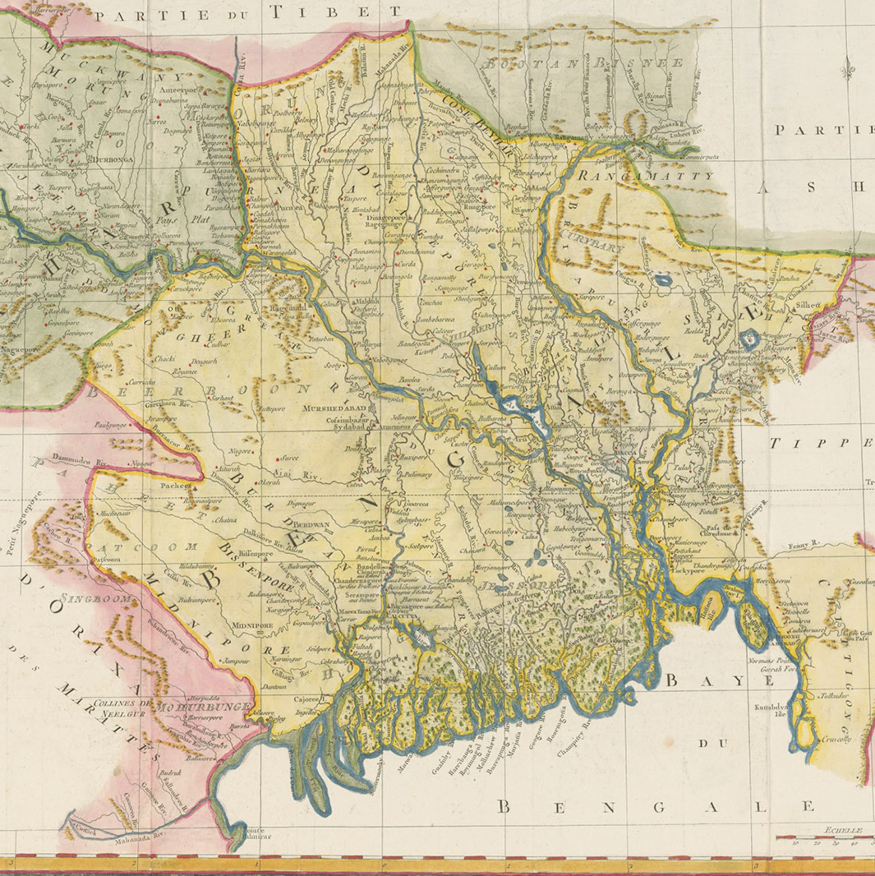
Rather than being a geographically defined region, Bengal represented a conceptual space oriented towards the lands surrounding the rivers, particularly the Ganges, that flowed towards the Bay of Bengal.
What is ‘Bengal’?

Slide 3
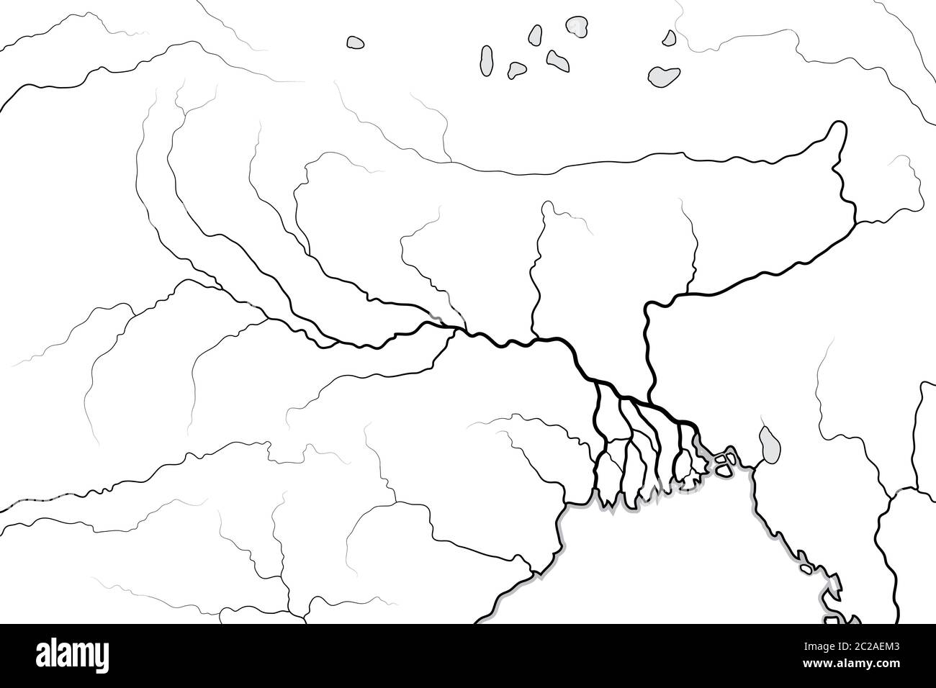
Waterways map of the Ganges
The Himalayas
Brahmaputra

Slide 4
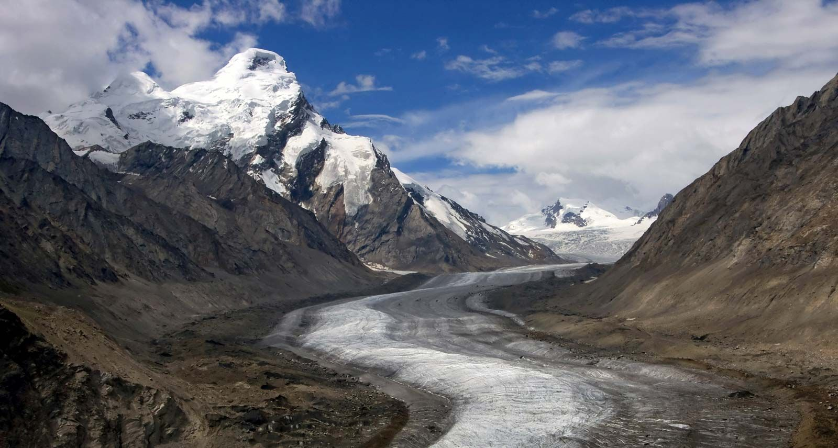
Ganges flowing through Himalayan Ridge

Slide 5
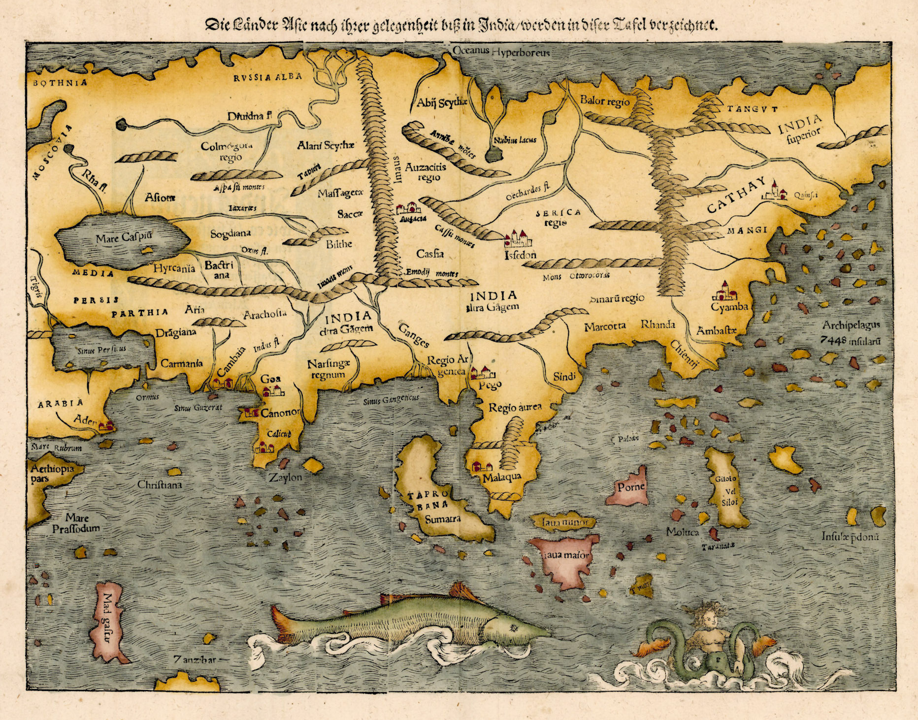
First Printed Map
German cartographer Sebastian Munster drew this first printed map of Asian continent.
Bengal can be found near the river Ganges

Slide 6
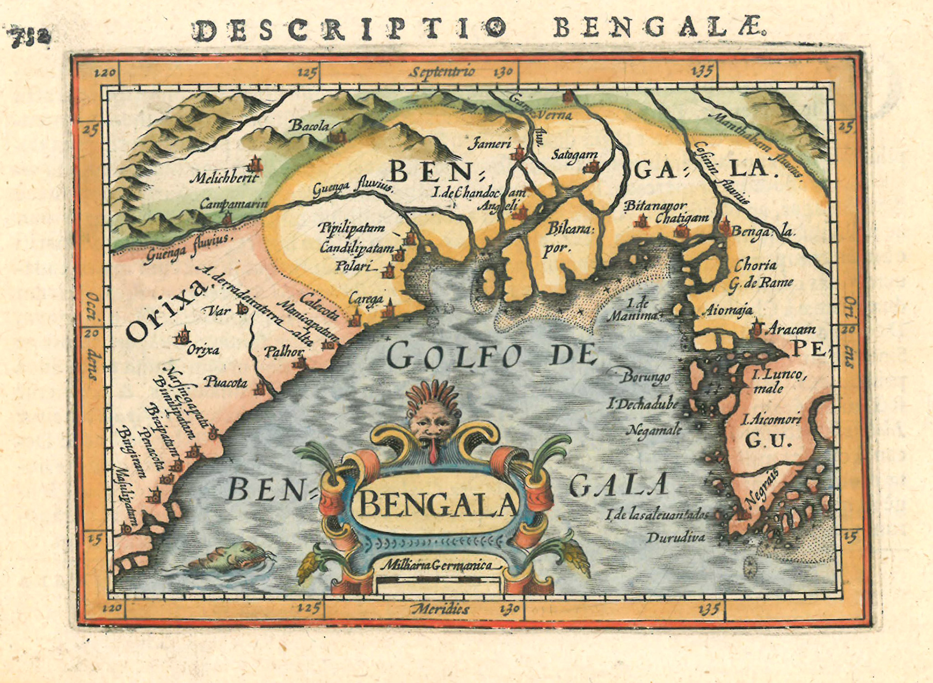
First Printed European Map
First printed European map with Bengal as its title.
It is taken from the miniature atlas “Tabularum Geographicarum Contractarum” by the Flemish cartographer Petrus Betrius.

Slide 7
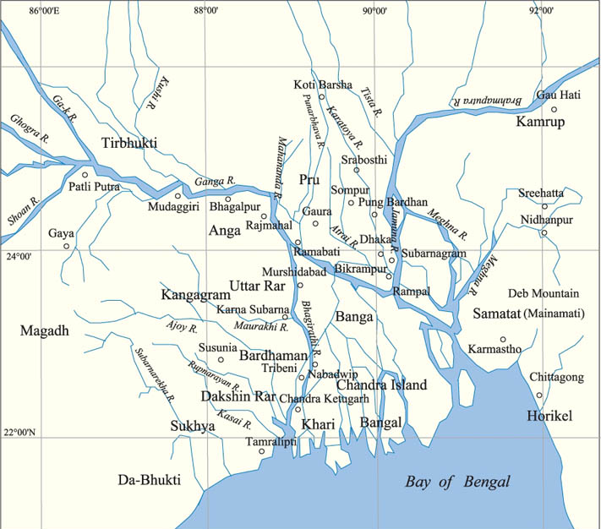
Ancient Bengal
Bengal has been a place for continuous human settlement because of its geography and climate. The rivers are the backbone of Bengal Delta that help to yield high crop productivity and promoted human settlement.
A place which ensures food-security always attracts people. By 2000 BCE, people started to settle around rivers and canals of this delta and practiced agriculture. It was around 1000 BCE, the growth of urban settlements i.e. the Mahajanapadas are found.

Slide 8
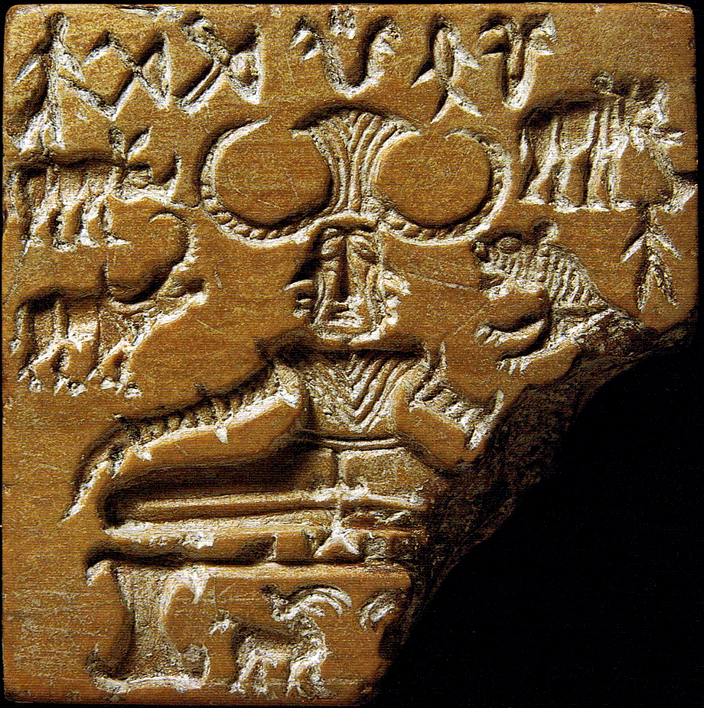
1
2
3
Indus Valley (2500–1700 BCE)
Bath house
Tower
Sigil of Pashupati/Tribe/Deity

Slide 9
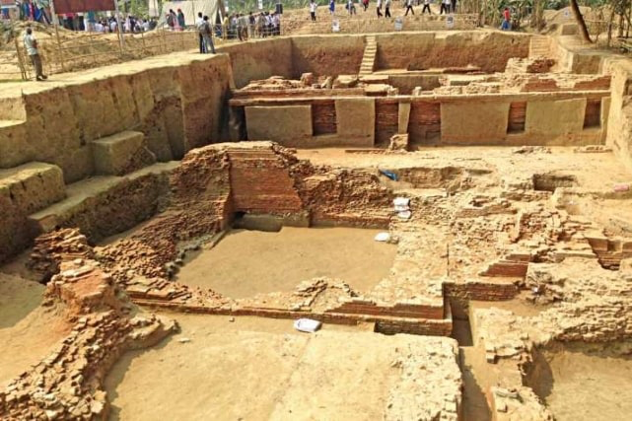
Wari-Bateshwar
Situated in Narsingdi, dating back to approximately 2450 years, this was the settlement of one of the ancient Mahajanapadas, an important trading centre and a river port

Slide 10
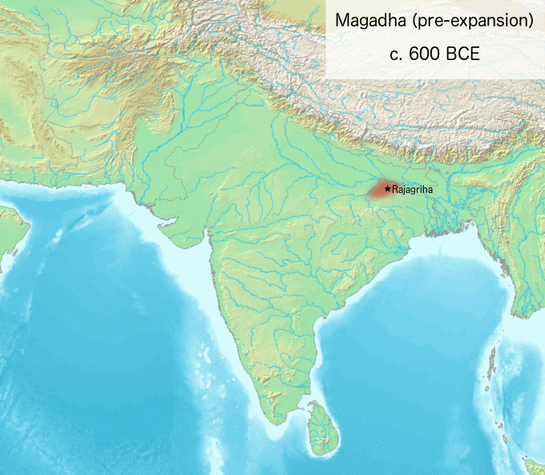
Bengal under the Mauryans
The Mauryans unified most parts of the Indian subcontinent.
During this time, the Mauryans built the Grand Trunk Road which facilitated the trade and attracted people from around the globe.
Emperor Asoka played an important role by sponsoring Buddhism. He sent missionaries, bureaucrats and trades in various places with Buddhist artifacts & doctrine. This diplomatic move connected Bengal with other regions of the subcontinent and especially south-east Asia.

Slide 11
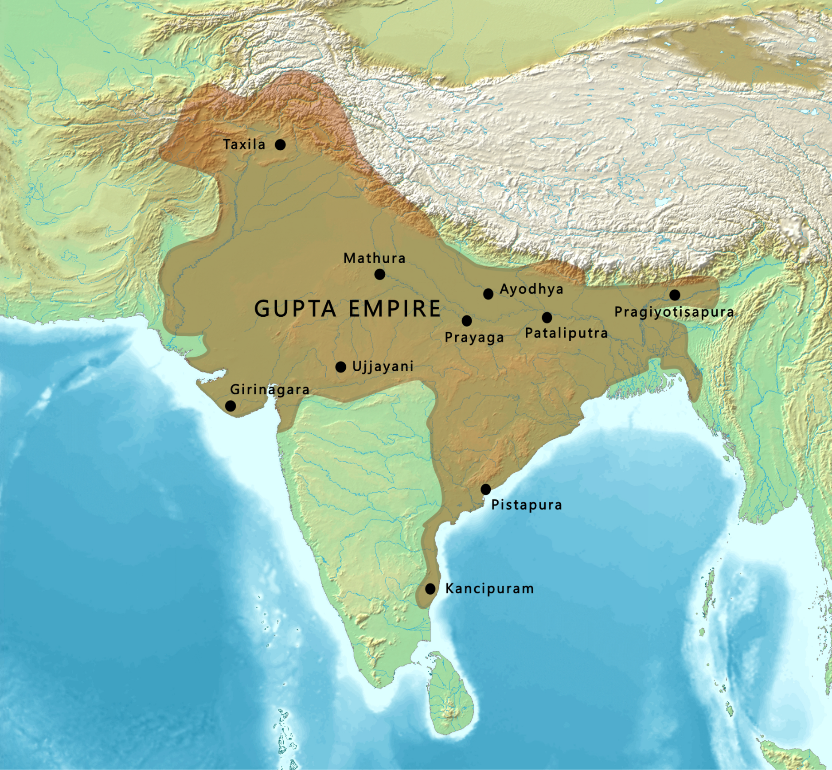
Bengal under the Guptas
Bengal was an important province of the Guptas.
During this time, the Guptas enforced well-organized administrative system.
This era witnessed the development of art and sculpture.
This is the second time after the Mauryans Bengal became part of and connected to the other parts of Indian subcontinent under one administration

Slide 12
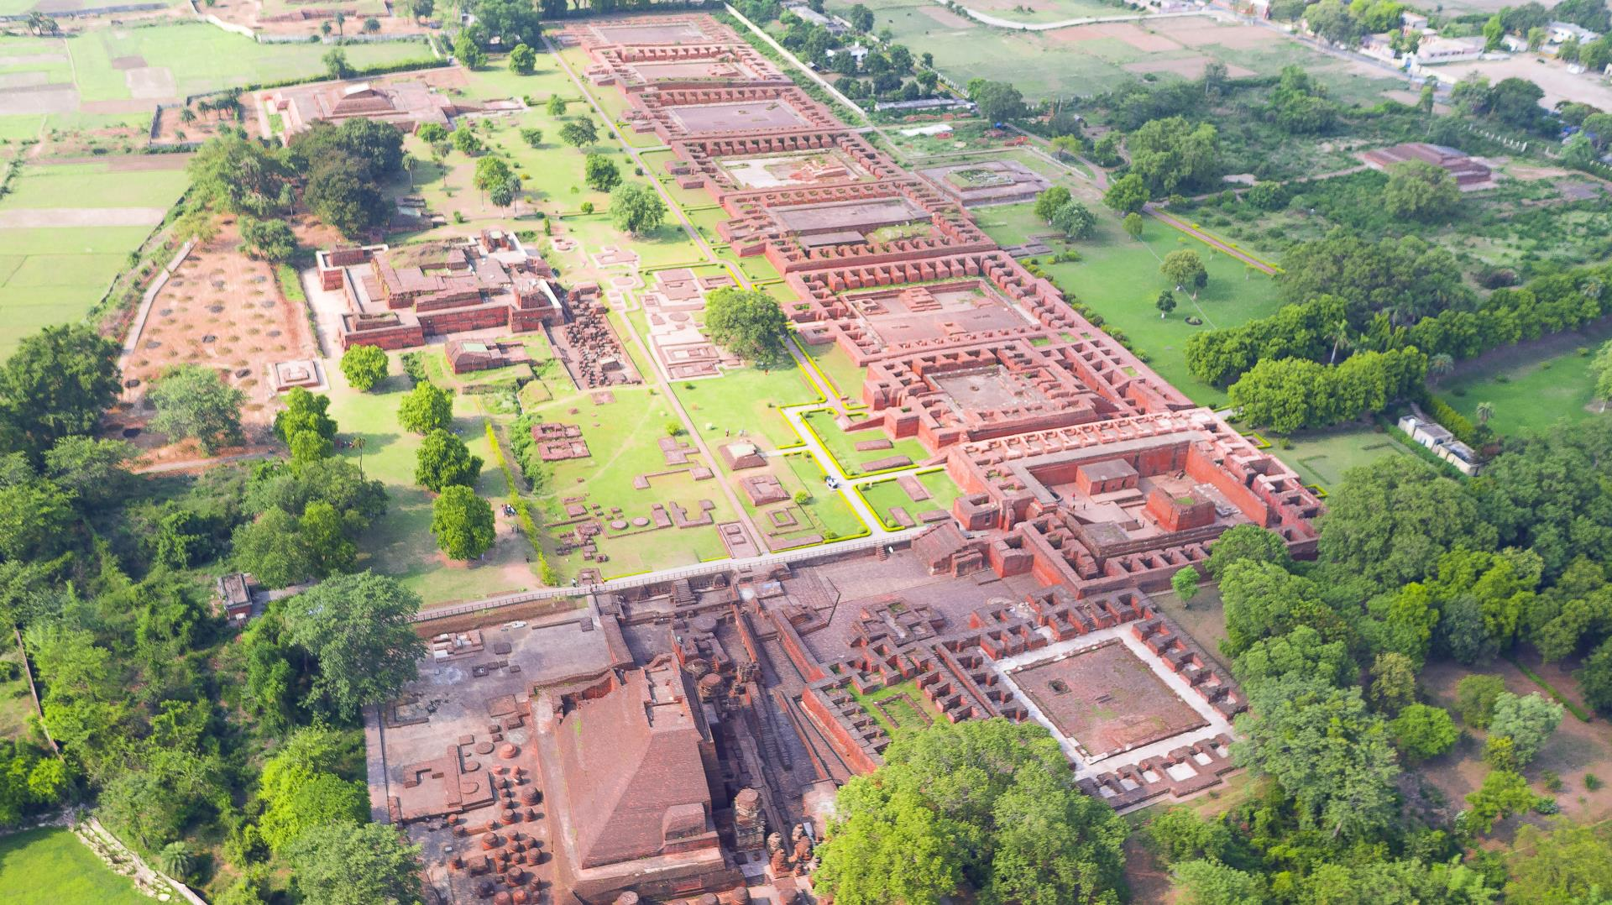
Nalanda University
Established around 427CE by the Gupta’s.
Was one of the world's earliest residential universities
The university's library, "Dharma Gunj" or "Mountain of Truth," housed millions of books and manuscripts.

Slide 13
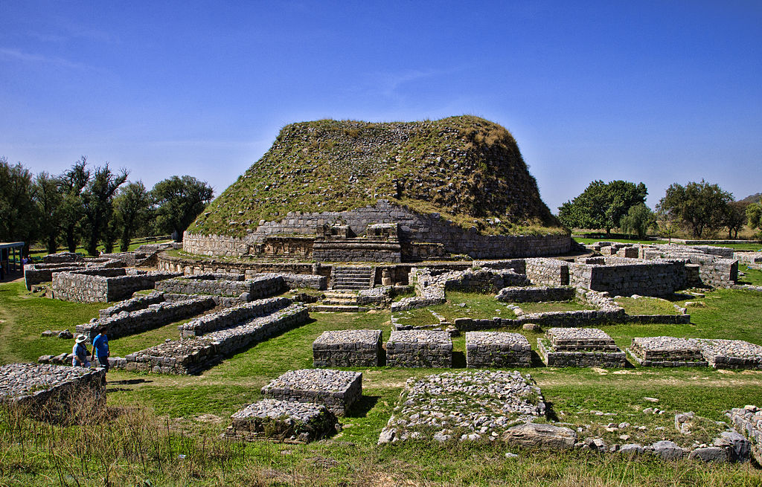
Taxila
Taxila is considered one of the world's earliest universities, predating Nalanda and Alexandria.
The university offered a wide range of subjects, including philosophy, medicine, astronomy, grammar, and military science.
Taxila played a crucial role in the spread of Buddhism

Slide 14

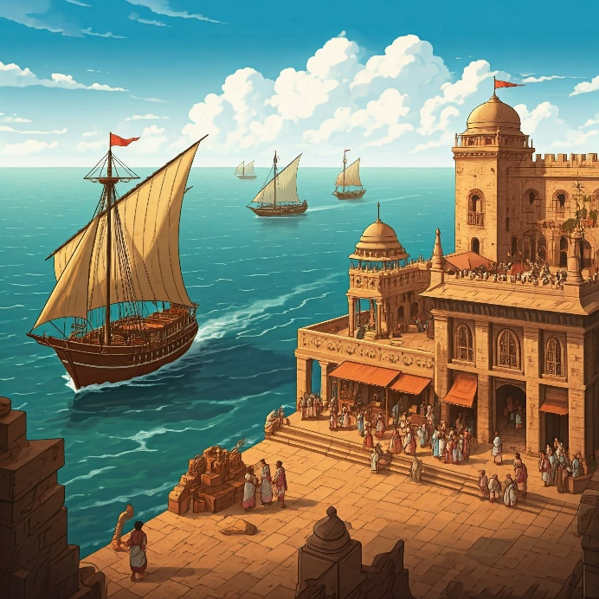
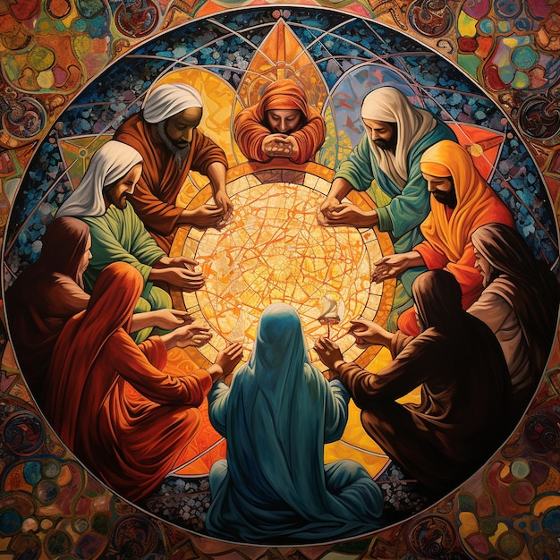
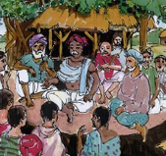
Local rulers from Bengal- the Pala, Sena, Deva, Chandra, Verman-
Local Rulers from Bengal
Sponsored learning centers
Instrumentalized a welcoming administrative system
Excelled in trade
Maintained religious harmony

Slide 15
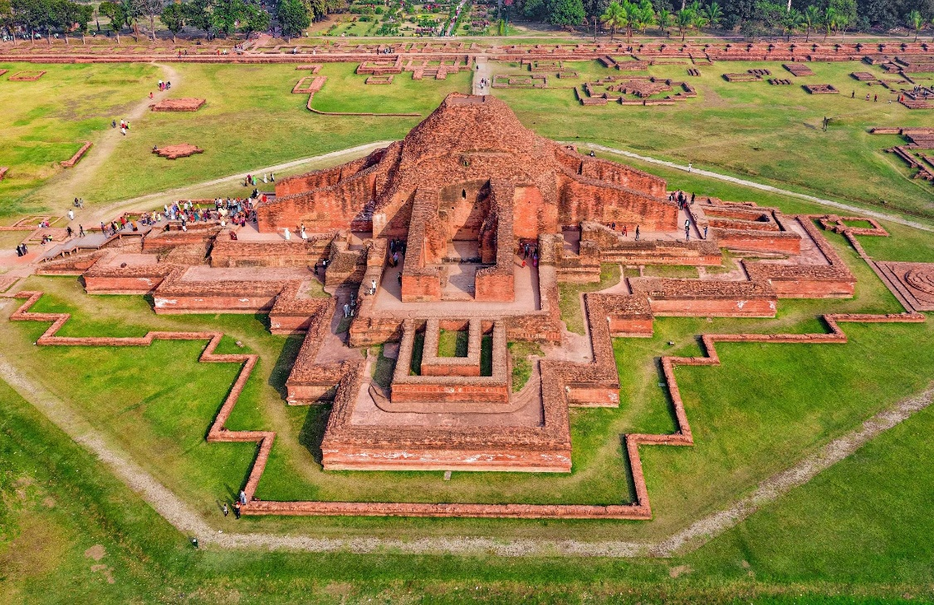
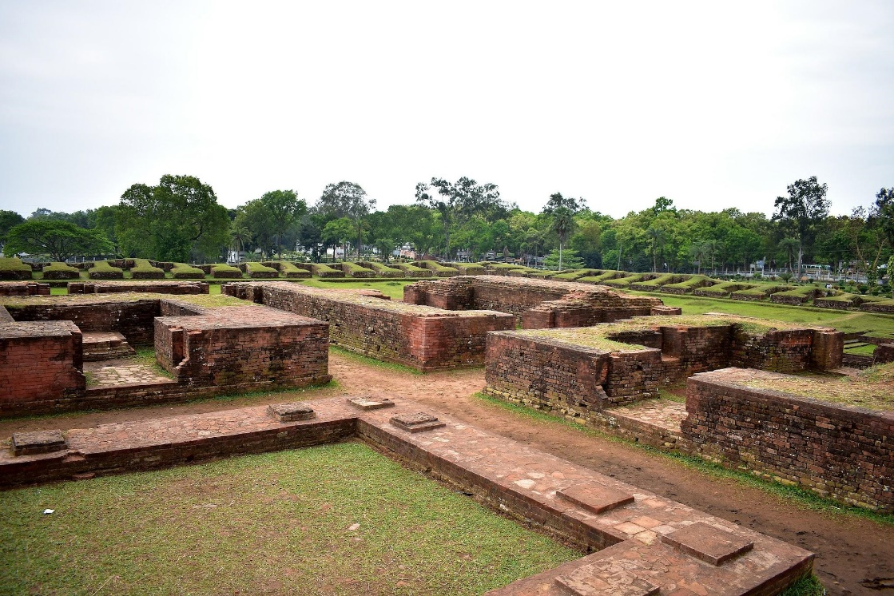
Contributions of the Rulers from Bengal
Shashanka, the king of Gauda Kingdom, developed the Bengali Calendar - ‘Bangabdo’
- Matsanyaya
- The Palas directly sponsored several learning institutions such as Somapura Mahavihara, Nalanda Mahavihara and Vikramshila Mahavihara. They helped to spread Buddhism and Buddhist art in Bengal.
- During this time, Bengali, the language of this land, took the central stage. Several Sanskrit and Pali texts were written and translated into Tibetan and Chinese.
- Admixture of Hindu and Buddhist doctrine into the social fabric of Bengal
Somapura Mahavihara established by Dharmapala in 6th century
Shalvan Mahavihara established by Bhavadeva in 8th century

Slide 16
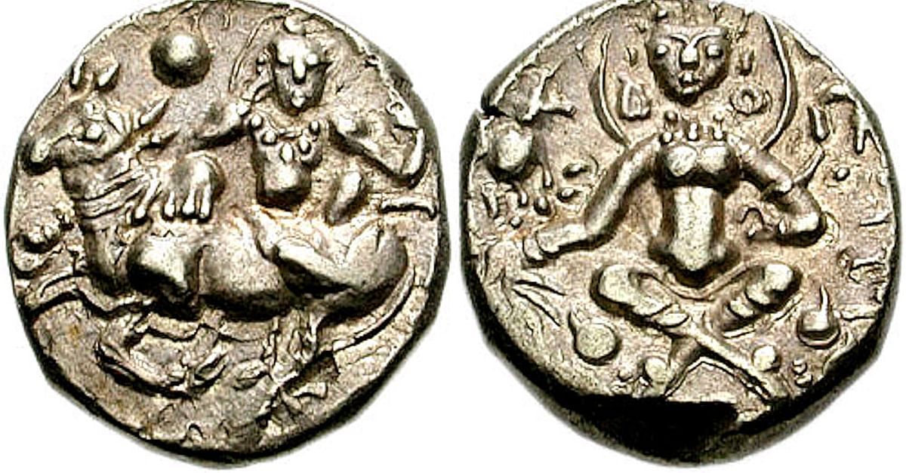
Coin of Shashanka
The Shashanka’s dynasty, which ruled Bengal during 7th century AD, minted a variety of coins, primarily made of gold. However recent exploration confirmed there were silver coins too.
Source: Bhattacharyya, P. K. (1979). Two interesting coins of Śaśāṅka1. Journal of the Royal Asiatic Society, 111(2), 153-155.

Slide 17

Matsanyaya

Slide 18
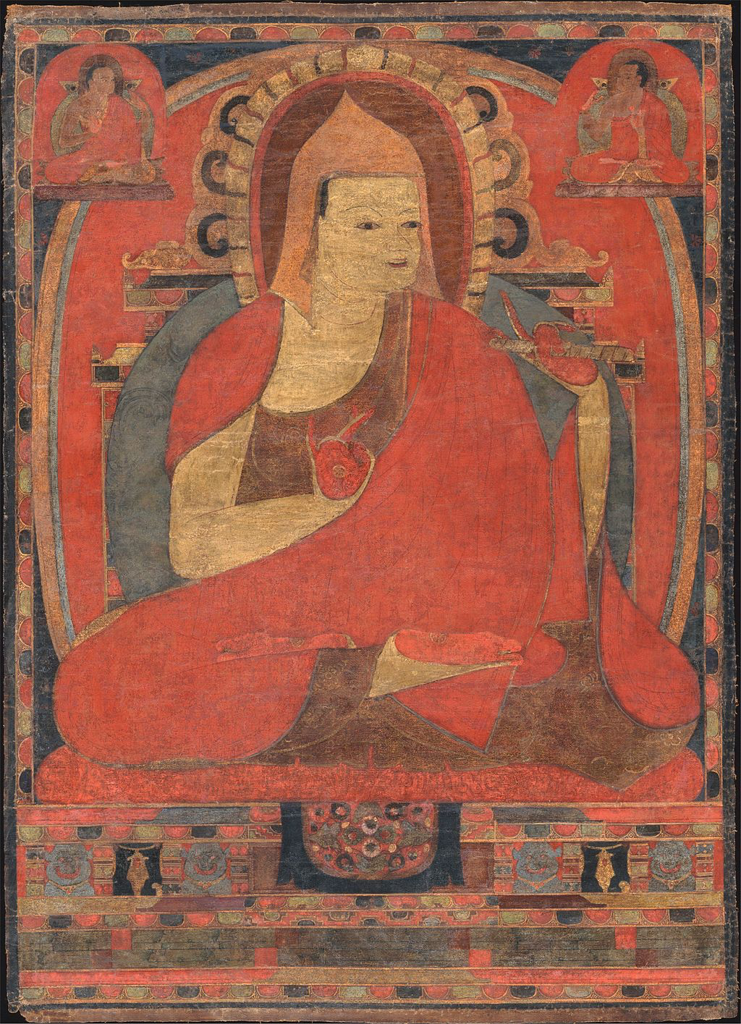
Ancient Seat of Learning
Pre-Islamic Bengal experience excellence in knowledge because of the several scholars from Bengal contributed immensely to the field of knowledge of Philosophy, Science and Arts.
Atish Dipankar was one of the pioneers of Buddhist philosophy. He home is in Bikrampur, commonly known as Nastik Panditer Bhita. He was invited by the king of Tibet to teach Buddhism in Tibet. He pioneered the Mahayana and Vajrayana Buddhism.

Slide 19
“… in this complex world of multiple and transforming religious identities a new creed, Islam, entered in two separate waves. In first, reached coastal Bangladesh as a by-product of seaborne trade between the eighth and twelfth centuries”. Secondly, “in the early thirteenth century Islam also reached Bangladesh by land route, this time as the religion of powerful invaders.”
History of Bangladesh | Willem van Schendel | 2009

Slide 20
Earliest evidence of human settlement in Bengal Delta
Rulers from the Guptas, Palas, Chandras, Devas, Senas etc. ruled Bengal.
Gradual emergence of Urban Settlements
2,000 BCE
350- 50 BCE
20,000 BCE
1,000 BCE
400- 1300 CE
Settlement of rice-cultivating communities
Bengal under the Mauryan Empire

Slide 21
Suggested Readings
Required Reading:
Salahuddin, A. F. (2004). Bangladesh National Culture and Heritage. Dhaka : IUB.
Pages: 53-65
Recommended Readings:
Sengupta, N. (2011). Land of Two Rivers. India: Penguin Books
Rahim, M. A., Choudhury, A. M., Mahmud, A. B. M. & Islam, S. (2005). Bangladesher Etihash (History of Bangladesh). Dhaka: Nouruj Kitabistan.

Slide 22
?

Slide 23
Next Class Preview
From Origins of Bengal Sultanates to the Battle of Polashi (1204-1757): Society, Religion and Politics

